Slide 1
Goals of Visualization
Visualization
Goals of visualization
Visualizing distributions
Kernel density estimation

Slide 2
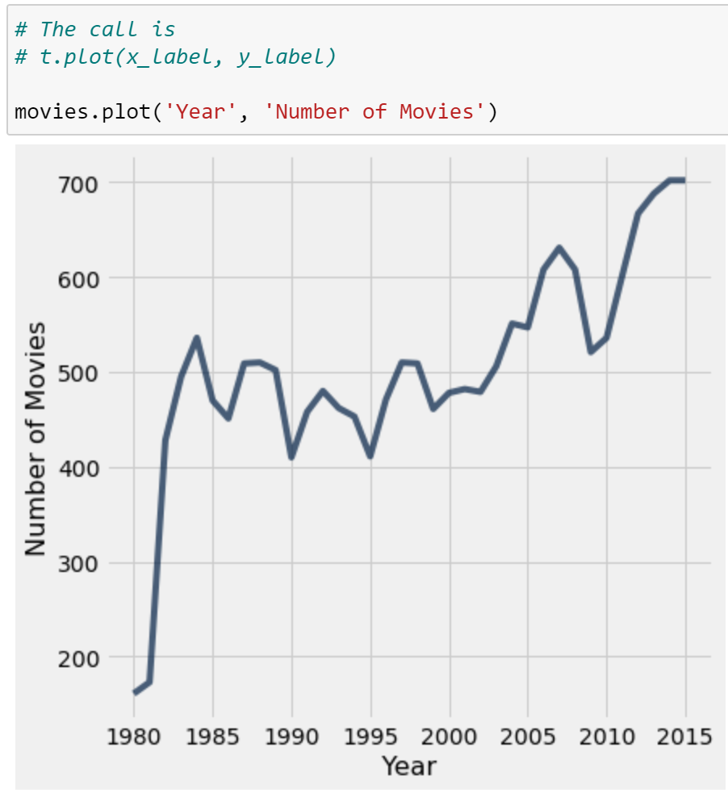
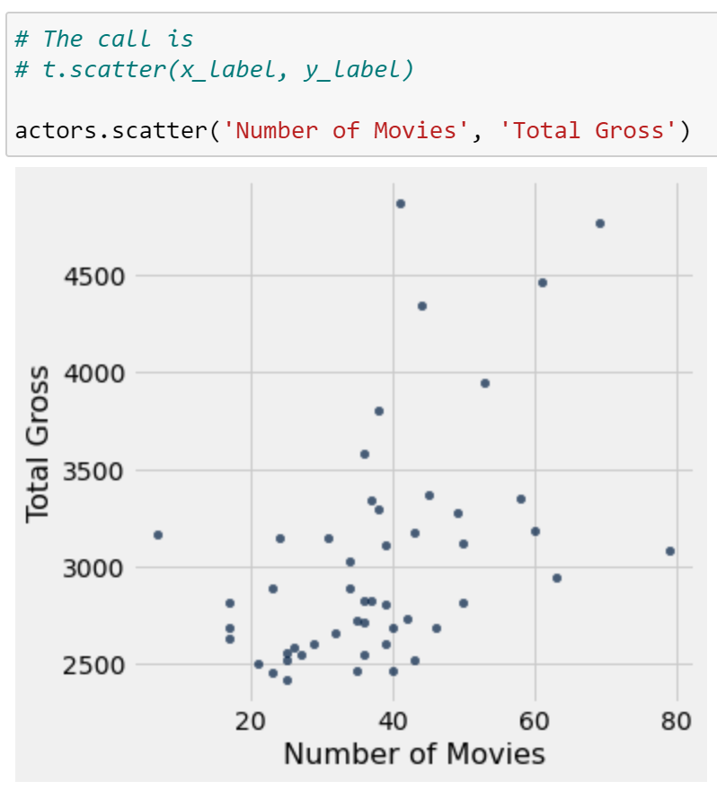
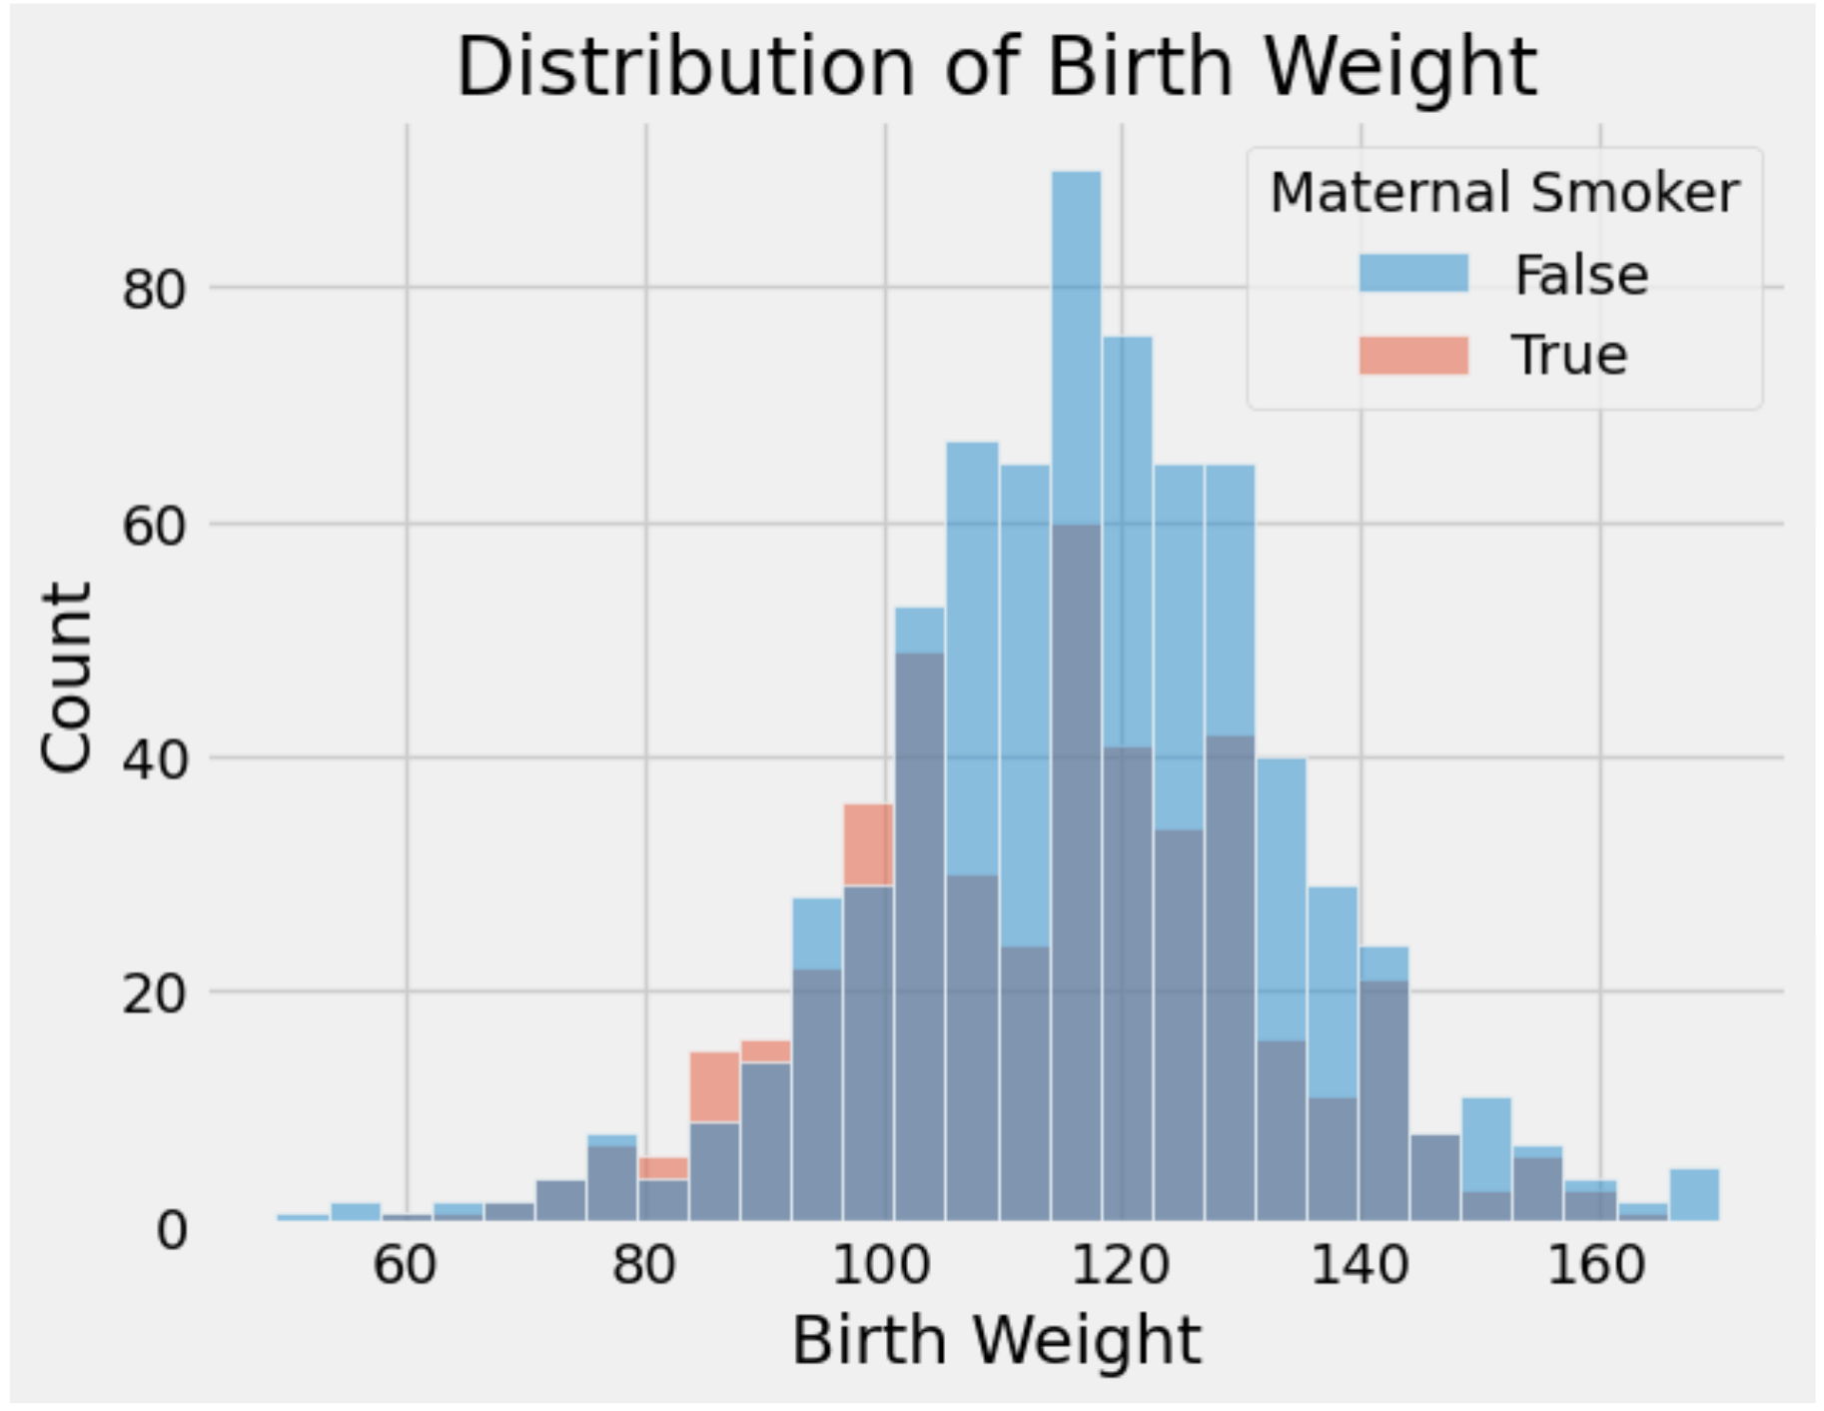
Visualizations so far
.
Line plot
Scatter plot
Histogram
What did these achieve?
Provide a high-level overview of a complex dataset.
Communicated trends to viewers.
Notes:
Maps tell one story, time series another.
The importance of one very well-selected metric.
Re-purposing bar charts (great for ranking!) to watch ranks change with time.
Model outputs can be data to be visualized. Data vis can make way for a data dashboard. G

Slide 3
Goals of Data Visualization
Goal 1: To help your own understanding of your data/results.
Key part of exploratory data analysis.
Summarize trends visually before in-depth analysis.
Lightweight, iterative and flexible.
What do these goals imply?
Visualizations aren't a matter of making "pretty" pictures.
We need to do a lot of thinking about what stylistic choices communicate ideas most effectively.
Goal 2: To communicate results/conclusions to others.
Highly editorial and selective.
Be thoughtful and careful!
Fine-tuned to achieve a communications goal.
Considerations: clarity, accessibility, and necessary context.

Slide 4
Goals of Data Visualization
What do these goals imply?
Visualizations aren't a matter of making "pretty" pictures.
We need to do a lot of thinking about what stylistic choices communicate ideas most effectively.
First half of visualization topics : Choosing the "right" plot for
Introducing plots for different variable types
Generating these plots through code
Second half of visualization topics : Stylizing plots appropriately
Smoothing and transforming visual data
Providing context through labeling and color

Slide 5
Visualizing Distributions
Regex
Regex review and regex functions
Visualization
Goals of visualization
Visualizing distributions
Kernel density estimation

Slide 6
Matplotlib and Seaborn
Matplotlib is a library in Python that enables users to generate visualizations like histograms, scatter plots, bar charts, pie charts and much more. Seaborn is a visualization library that is built on top of Matplotlib. It provides data visualizations that are typically more aesthetic and statistically sophisticated.

Slide 7
Distributions
A distribution describes…
The set of values that a variable can possibly take.
The frequency with which each value occurs.
…for a single variable
Example: Distribution of students across discussion sections in a course.
The list of discussion sections (10-11 am, 11-12 pm, etc.)
The number of students enrolled in each section
In other words: How is the variable distributed across all of its possible values?
This means that percentages should sum to 100% (if using proportions) and counts should sum to the total number of datapoints (if using raw counts).
Let's see some examples.

Slide 8
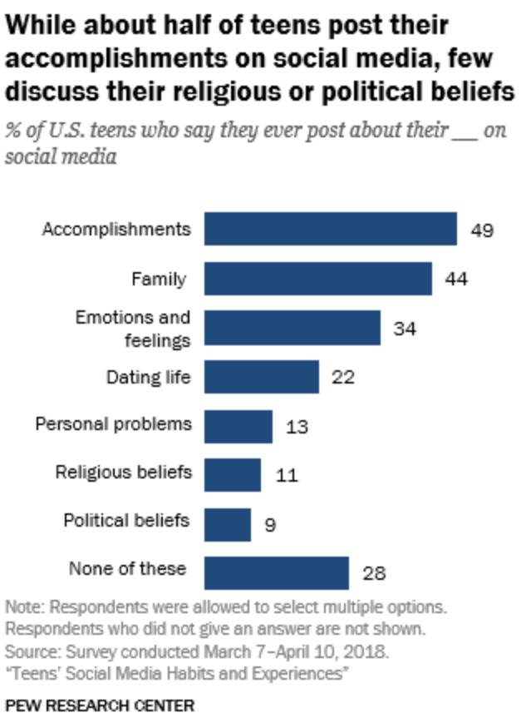
Does this chart show a distribution?
No.
The chart does show percents of individuals in different categories!
But, this is not a distribution because individuals can be in more than one category (see the fine print).
Notes:
https://www.pewresearch.org/internet/2018/11/28/teens-and-their-experiences-on-social-media/

Slide 9
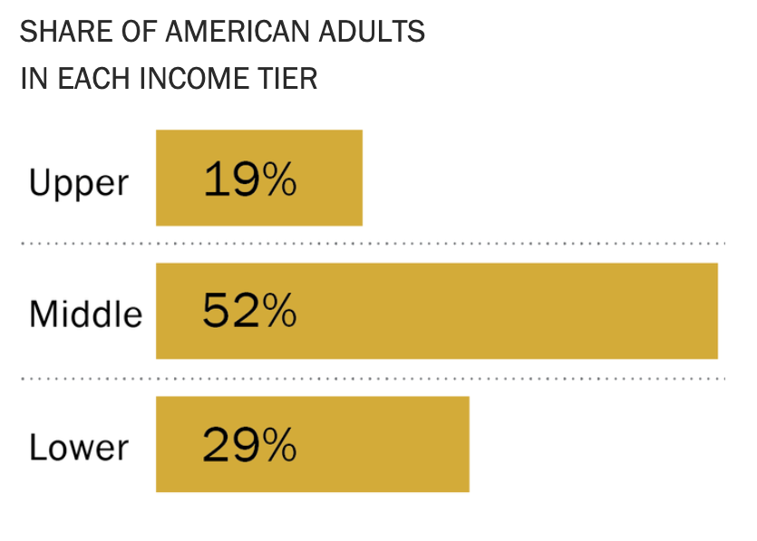
Does this chart show a distribution?
Yes!
This chart shows the distribution of the qualitative ordinal variable "income tier."
Each individual is in exactly one category.
The values we see are the proportions of individuals in that category.
Everyone is represented, as the total percentage is 100%.
Notes:
https://www.pewresearch.org/fact-tank/2018/09/06/are-you-in-the-american-middle-class/

Slide 10
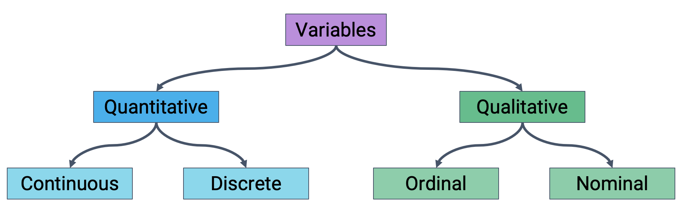
Variable Types Should Inform Plot Choice
Different plots are more or less suited for displaying particular types of variables.
First step of visualization: Identify the variables being visualized. Then, select a plot type accordingly.

Slide 11
Bar Plots: Distributions of Qualitative Variables
Bar plots are the most common way of displaying the distribution of a qualitative variable.
*Sometimes quantitative discrete data too, if there are few unique values.
For example, the proportion of adults in the upper, middle, and lower classes.
Lengths encode values.
Widths encode nothing!
Color could indicate a sub-category (but not necessarily).

Slide 12
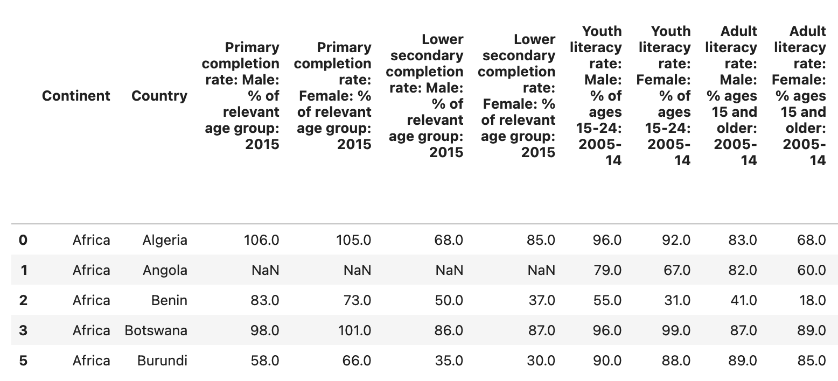
World Bank Dataset
We will be using the wb dataset about world countries for most of our work today.

Slide 13
Generating Bar Plots: Matplotlib
we will mainly use two libraries for generating plots: Matplotlib and Seaborn.
Most Matplotlib plotting functions follow the same structure: We pass in a sequence (list, array, or Series) of values to be plotted on the x-axis, and a second sequence of values to be plotted on the y-axis.
Matplotlib is typically given the alias plt
import matplotlib.pyplot as plt
plt.plotting_function(x_values, y_values)
To add labels and a title:
plt.xlabel("x axis label")
plt.ylabel("y axis label")
plt.title("Title of the plot");

Slide 14
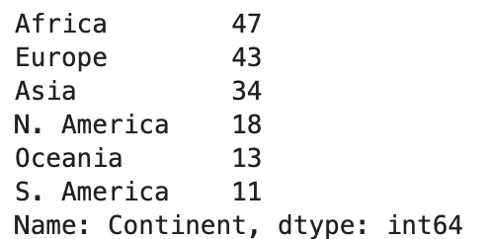
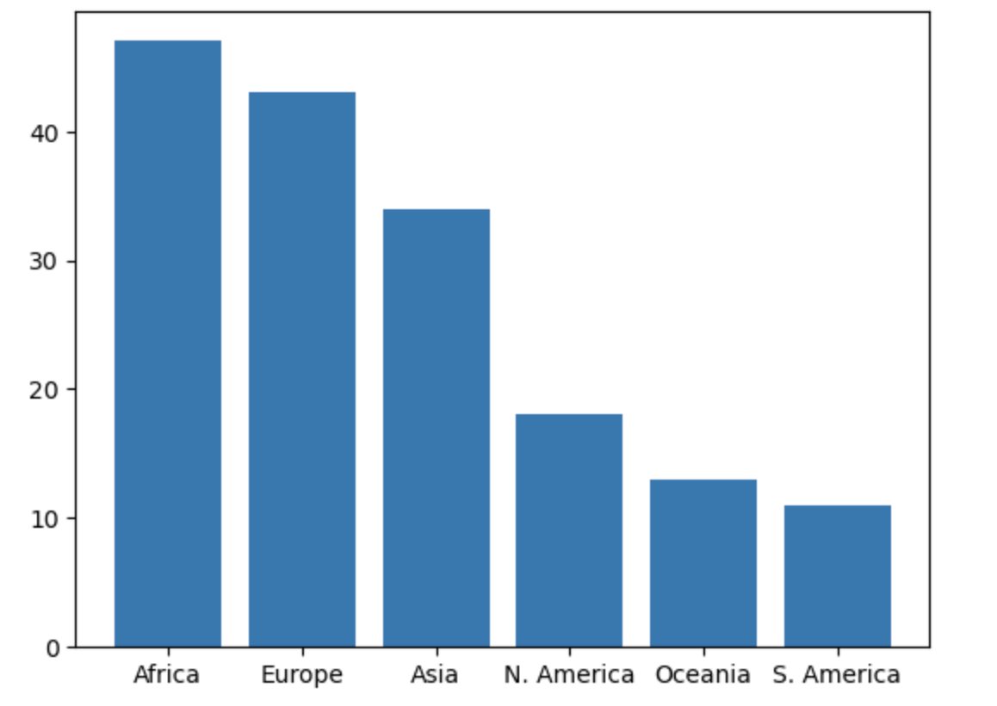
Generating Bar Plots: Matplotlib
To create a bar plot in Matplotlib: plt.bar( )
continents = wb["Continent"].value_counts()
plt.bar(continents.index, continents.values);
x values
y values

Slide 15
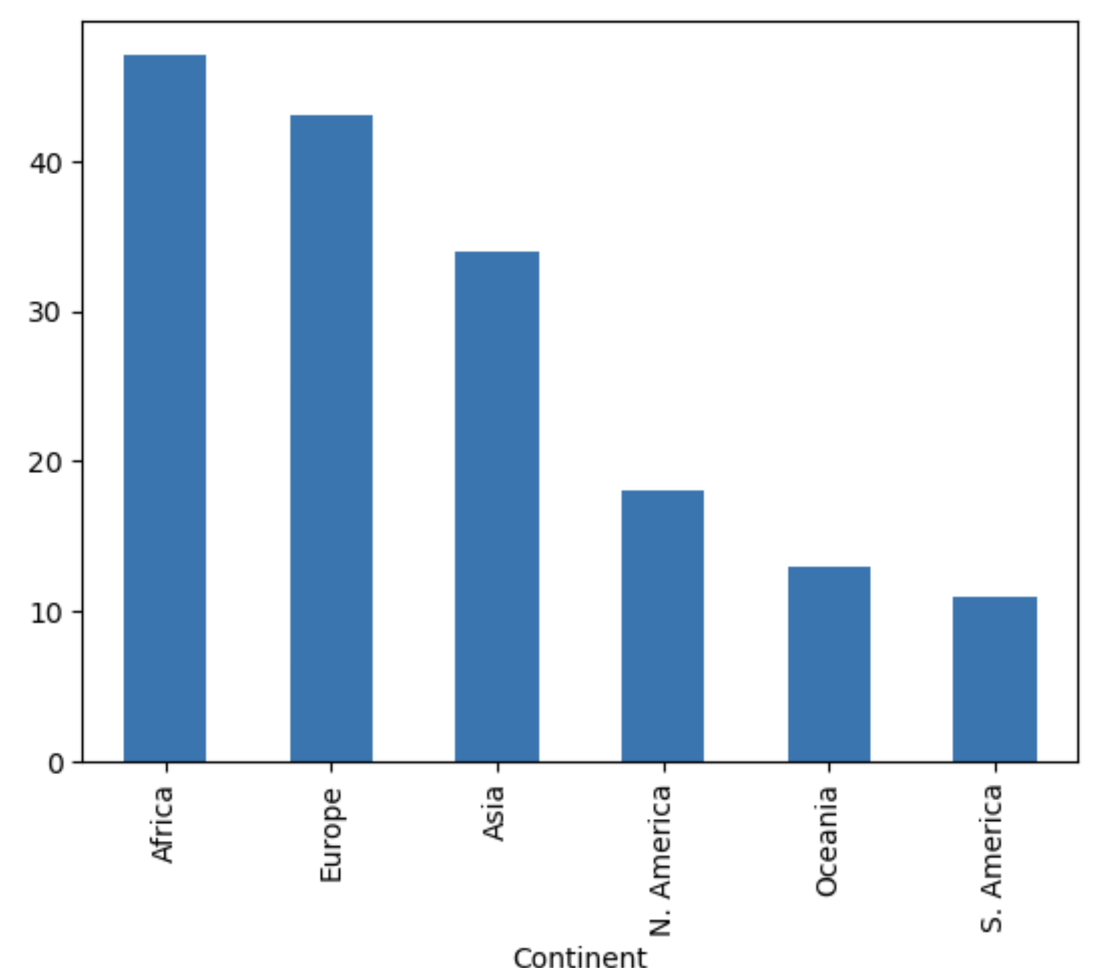
Generating Bar Plots: pandas Native Plotting
To create a bar plot in native pandas: .plot(kind='bar')
wb["Continent"].value_counts().plot(kind='bar')

Slide 16
Generating Bar Plots: Seaborn
Seaborn plotting functions use a different structure: Pass in an entire DataFrame, then specify what column(s) to plot.
Seaborn is typically given the alias sns
import seaborn as sns
sns.plotting_function(data=df, x="x_col", y="y_col")
To add labels and a title, use the same syntax as before:
plt.xlabel("x axis label")
plt.ylabel("y axis label")
plt.title("Title of the plot");

Slide 17
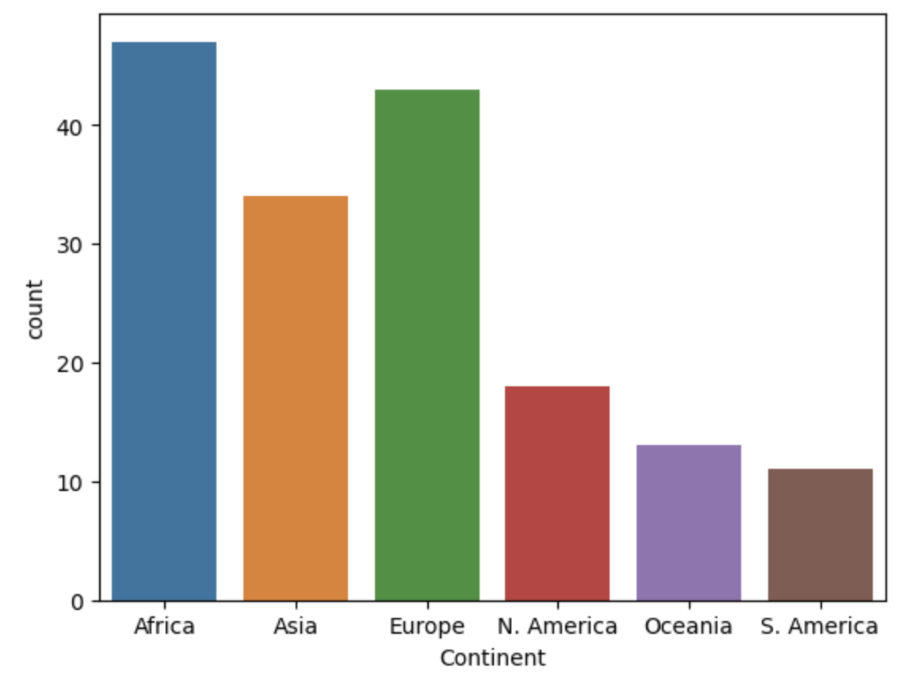
Generating Bar Plots: Seaborn
To create a bar plot in Seaborn: sns.countplot( )
countplot operates at a higher level of abstraction!
You give it the entire DataFrame and it does the counting for you.
import seaborn as sns
sns.countplot(data=wb, x="Continent");

Slide 18
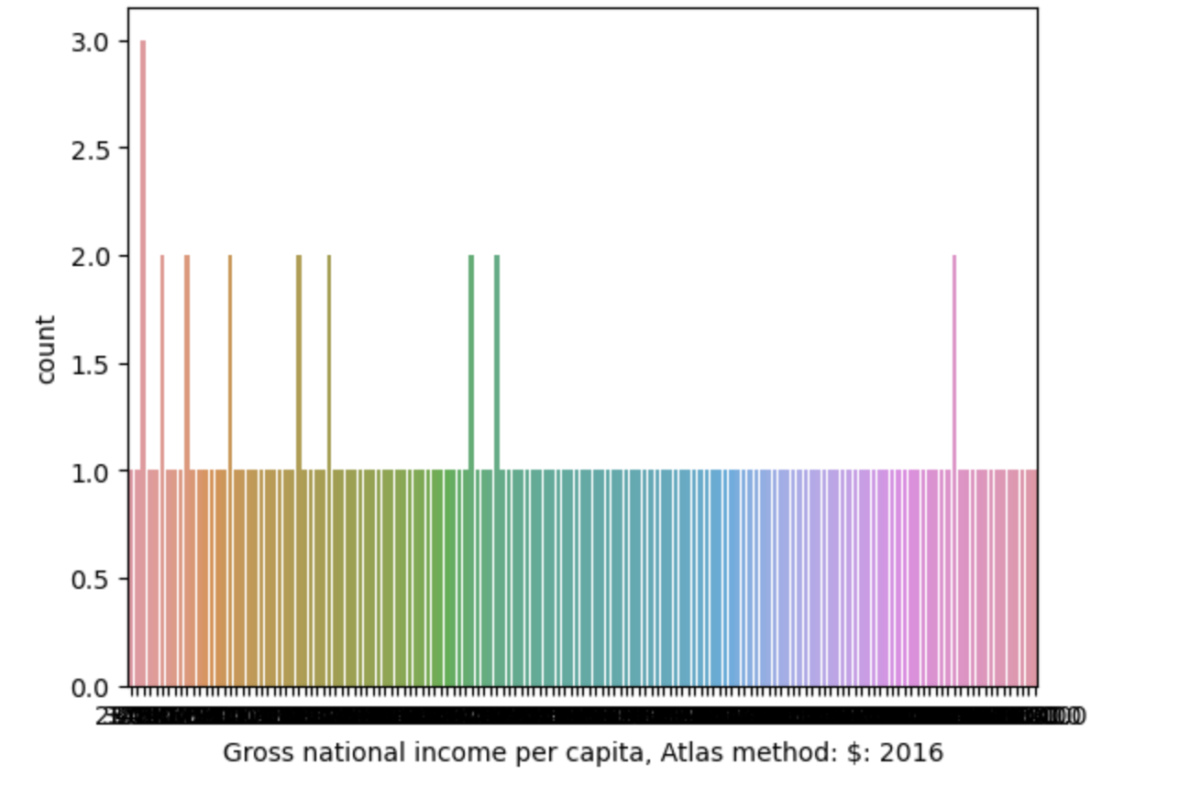
Distributions of Quantitative Variables
Earlier, we said that bar plots are appropriate for distributions of qualitative variables.
Why only qualitative? Why not quantitative as well?
For example: The distribution of gross national income per capita.
A bar plot will create a separate bar for each unique value. This leads to too many bars for continuous data!

Slide 19
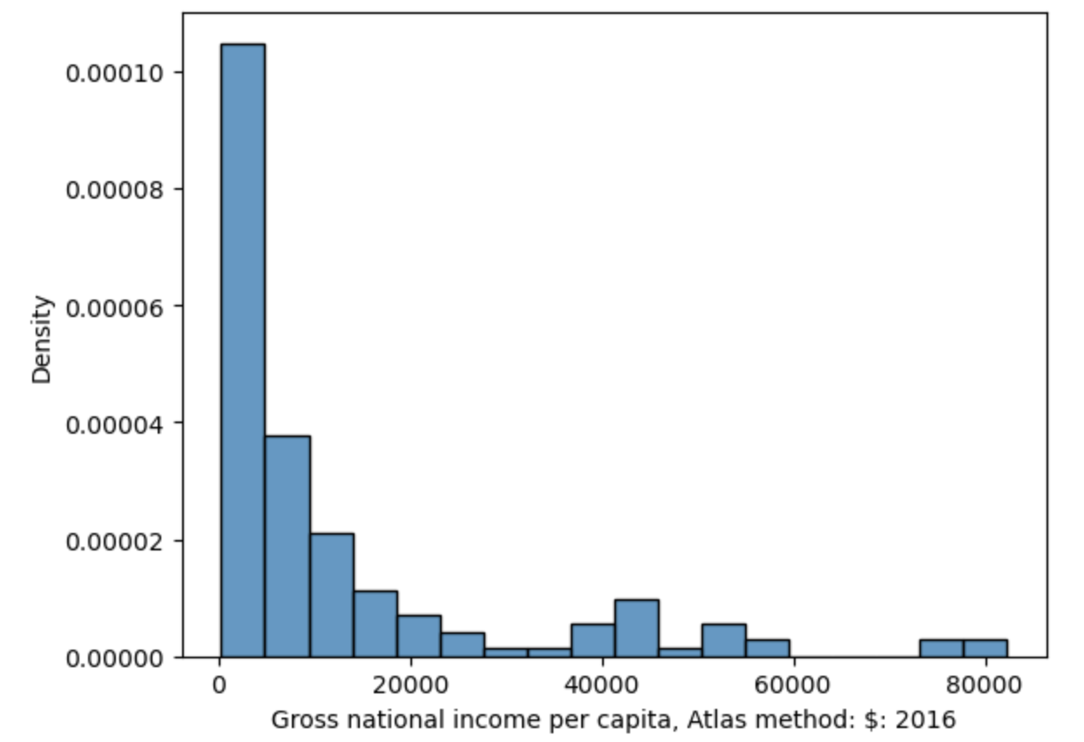
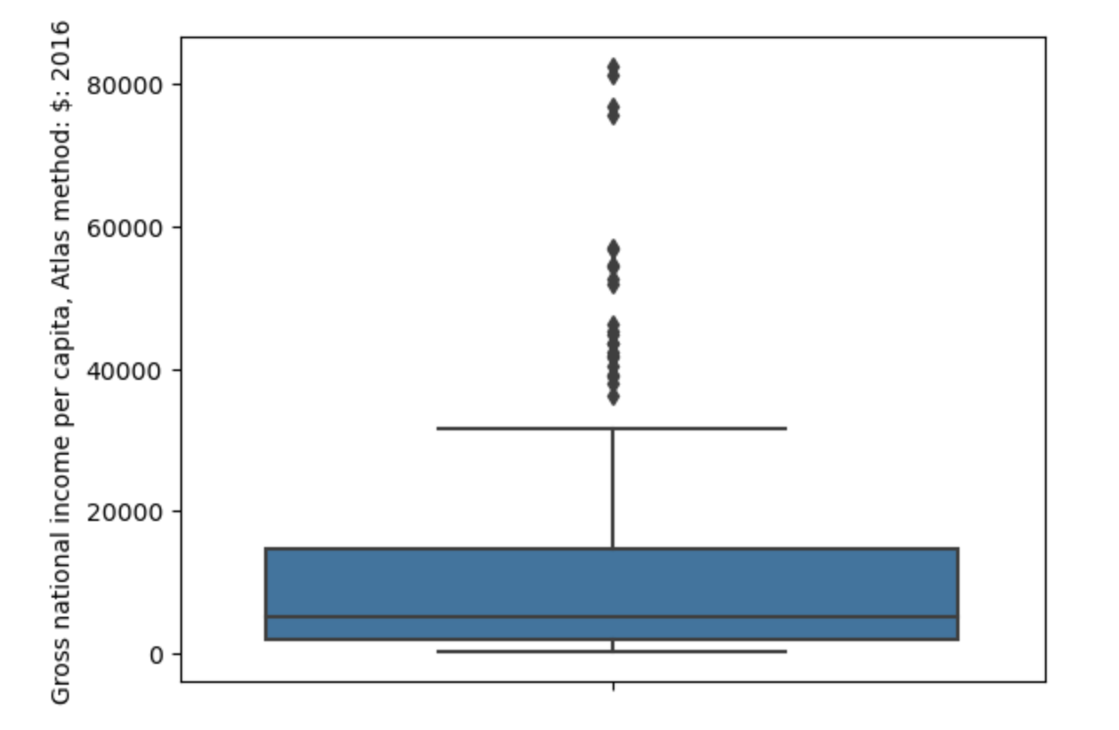
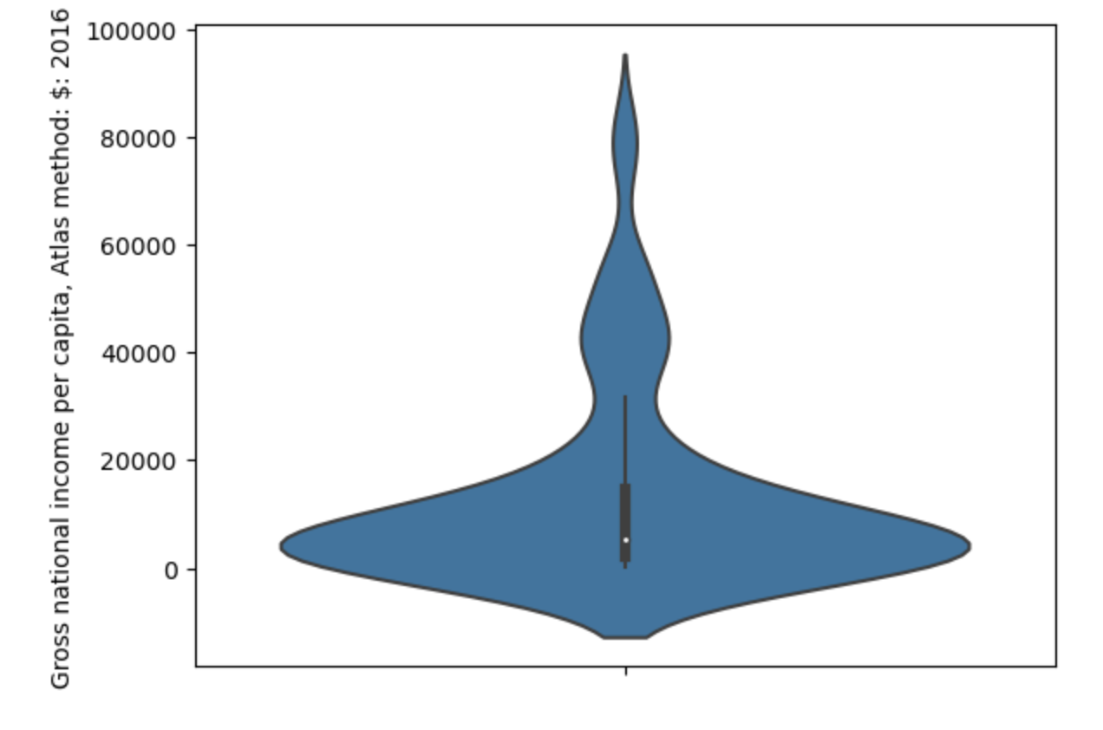
Distributions of Quantitative Variables
To visualize the distribution of a continuous quantitative variable:
Box plot
Violin plot
Histogram

Slide 20
Box plots and Violin Plots
Box plots and violin plots display distributions using information about quartiles.
In a box plot, the width of the box encodes no meaning.
In a violin plot, the width of the "violin" indicates the density of datapoints at each value.
sns.boxplot(data=df, y="y_variable");
sns.violinplot(data=df, y ="y_variable");

Slide 21
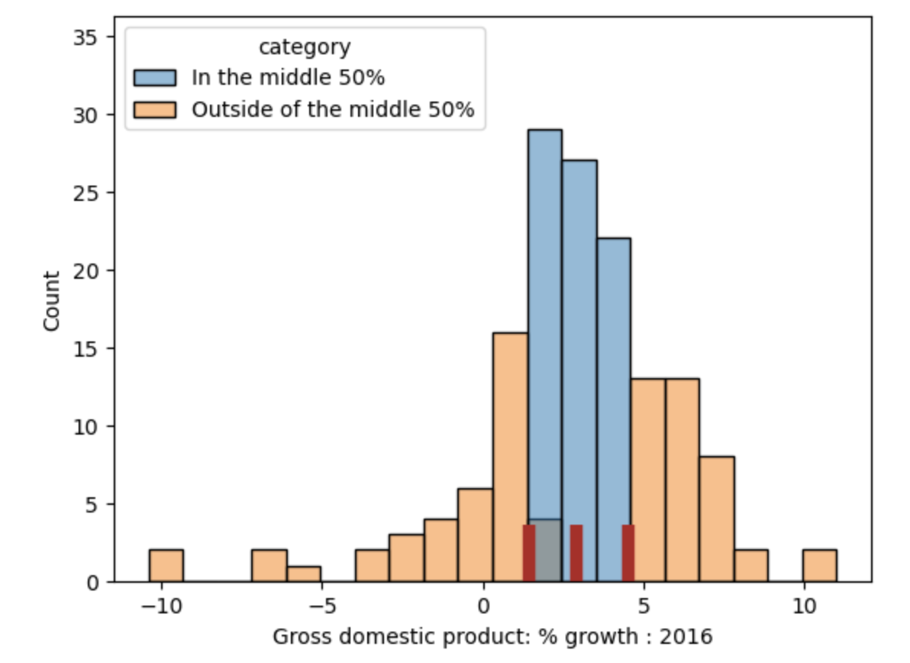
Quartiles
For a quantitative variable:
First or lower quartile: 25th percentile.
Second quartile: 50th percentile (median).
Third or upper quartile: 75th percentile.
The interval [first quartile, third quartile] contains the "middle 50%" of the data.
Interquartile range (IQR) measures spread.
IQR = third quartile – first quartile.
The length of this region is the IQR

Slide 22
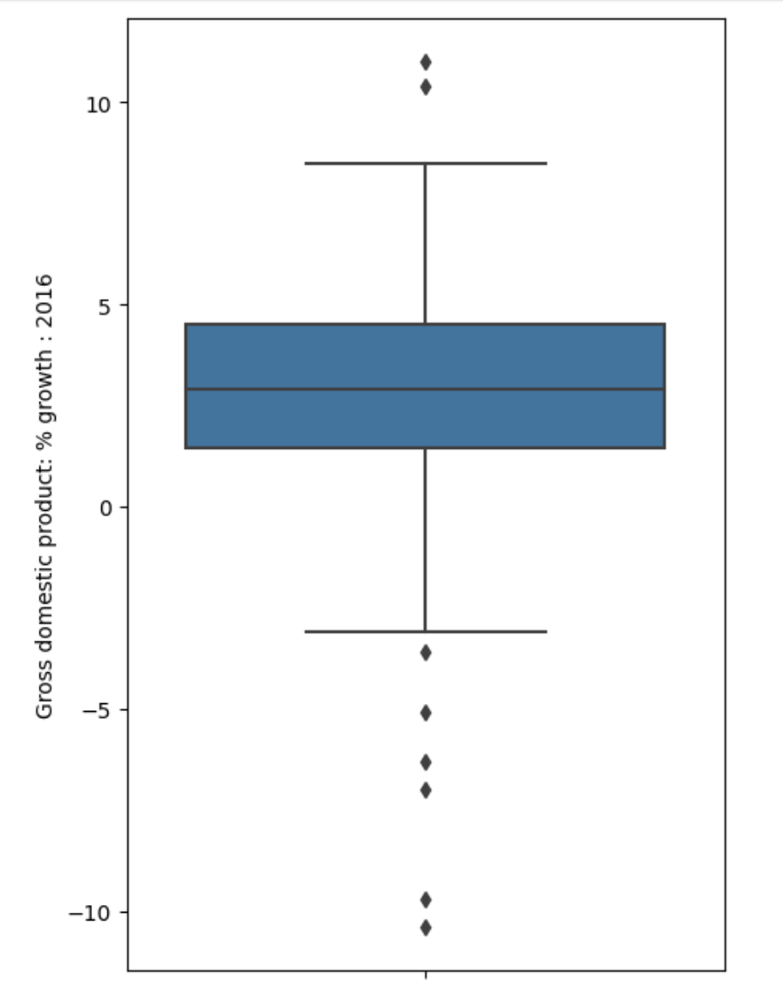
Box Plots
Outliers
Whisker: upper quartile + 1.5*IQR
Third quartile (75th percentile)
Second quartile (median)
First quartile (25th percentile)
Whisker: lower quartile - 1.5*IQR
Outliers
sns.boxplot(data=wb, y="Gross domestic product: % growth : 2016")

Slide 23
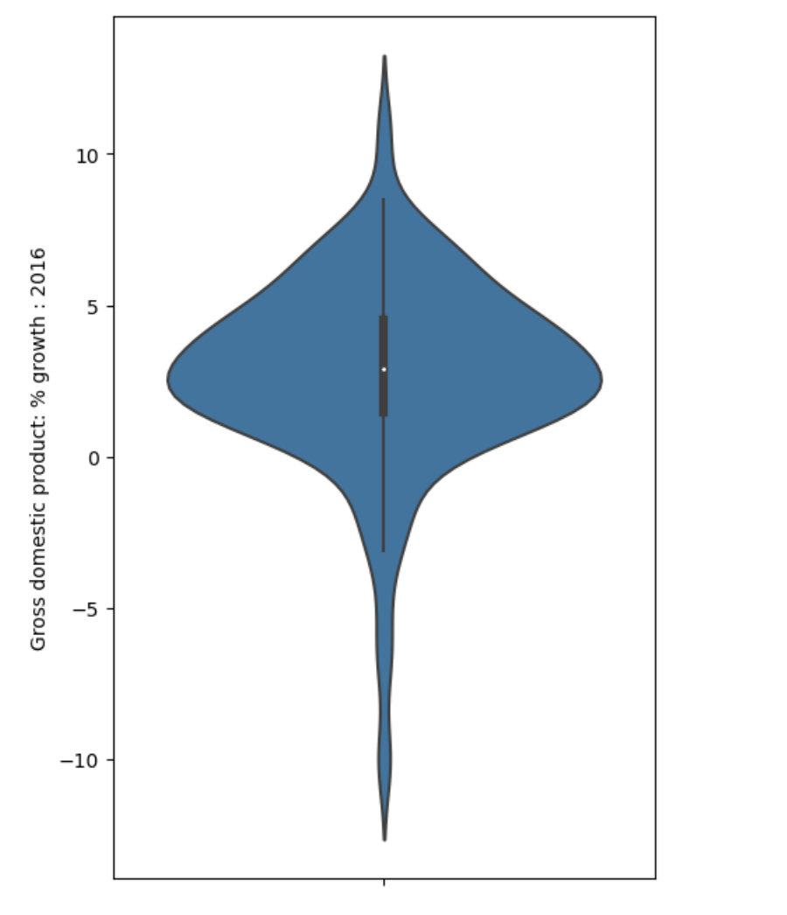
Violin Plots
Violin plots are similar to box plots, but also show smoothed density curves.
The "width" of our "box" now has meaning!
The three quartiles and "whiskers" are still present – look closely.
sns.violinplot(data=wb, y="Gross domestic product: % growth : 2016")

Slide 24
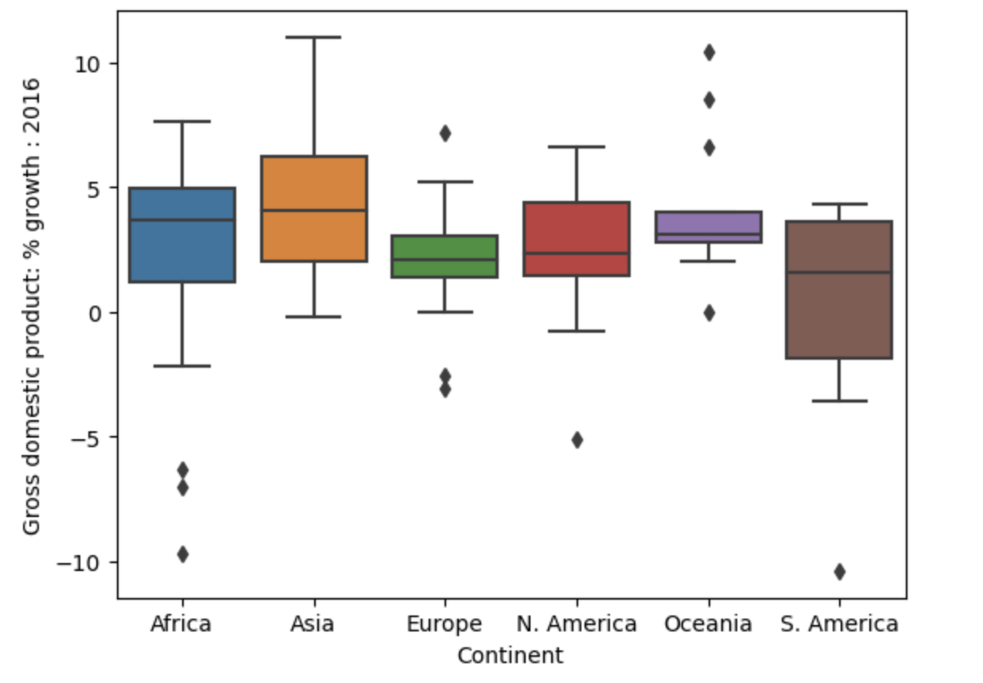
Side-by-side Box and Violin Plots
What if we wanted to incorporate a qualitative variable as well? For example, compare the distribution of a quantitative continuous variable across different qualitative categories.
sns.boxplot(data=wb, x="Continent", y="Gross domestic product: % growth : 2016");
GDP growth: quantitative continuous
Continent: qualitative nominal

Slide 25
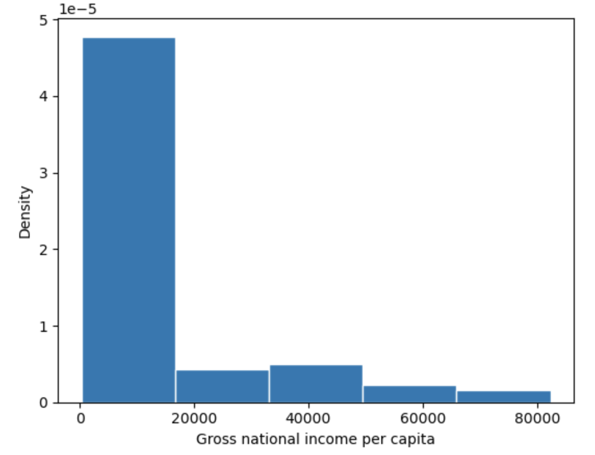
Histograms
A histogram:
Collects datapoints with similar values into a shared "bin".
Scales the bins such that the area of each bin is equal to the percentage of datapoints it contains
The first bin has a width of $16410
height of 4.77 x 10⁻⁵
This means that it contains 16410 x (4.77 x 10⁻⁵) = 78.3% of all datapoints in the dataset.

Slide 26
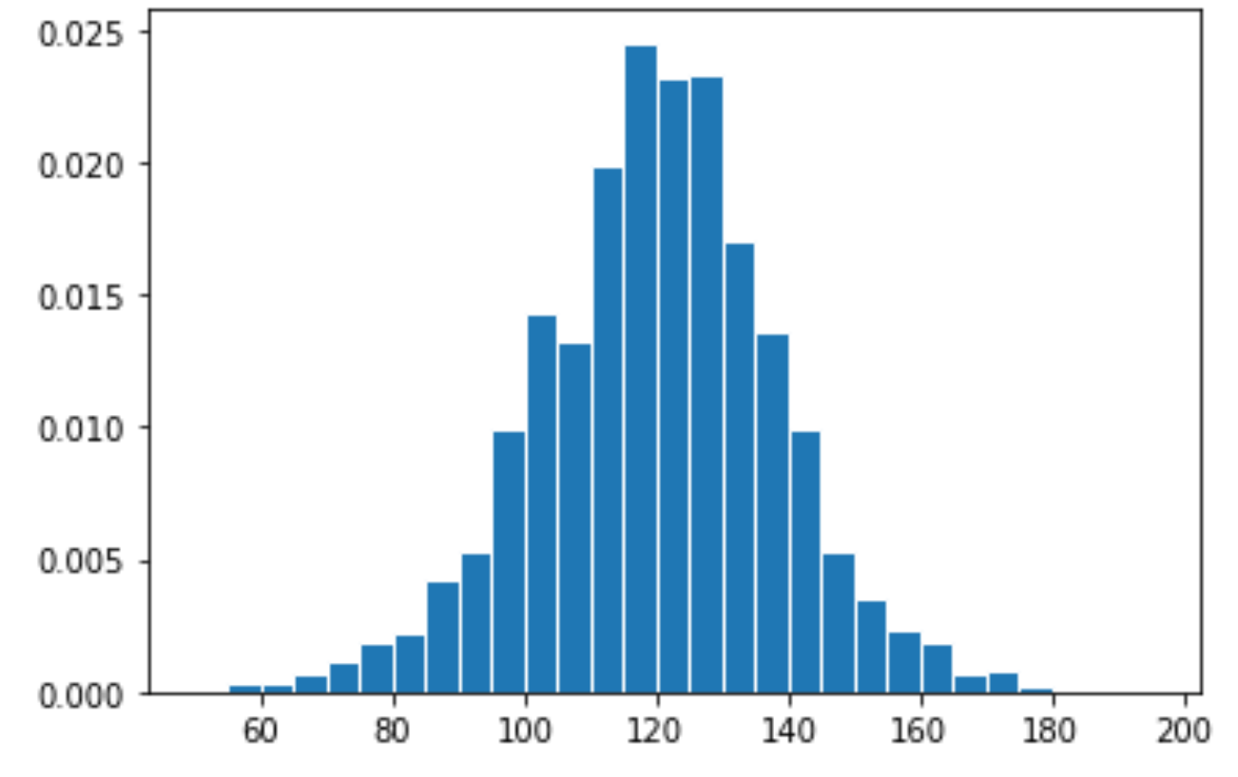
Answer
There are 1174 observations total.
Width of bin [110, 115): 5
Height of bar [110, 115): 0.02
Proportion in bin = 5 * 0.02 = 0.1
Number in bin = 0.1 * 1174 = 117.4

Slide 27
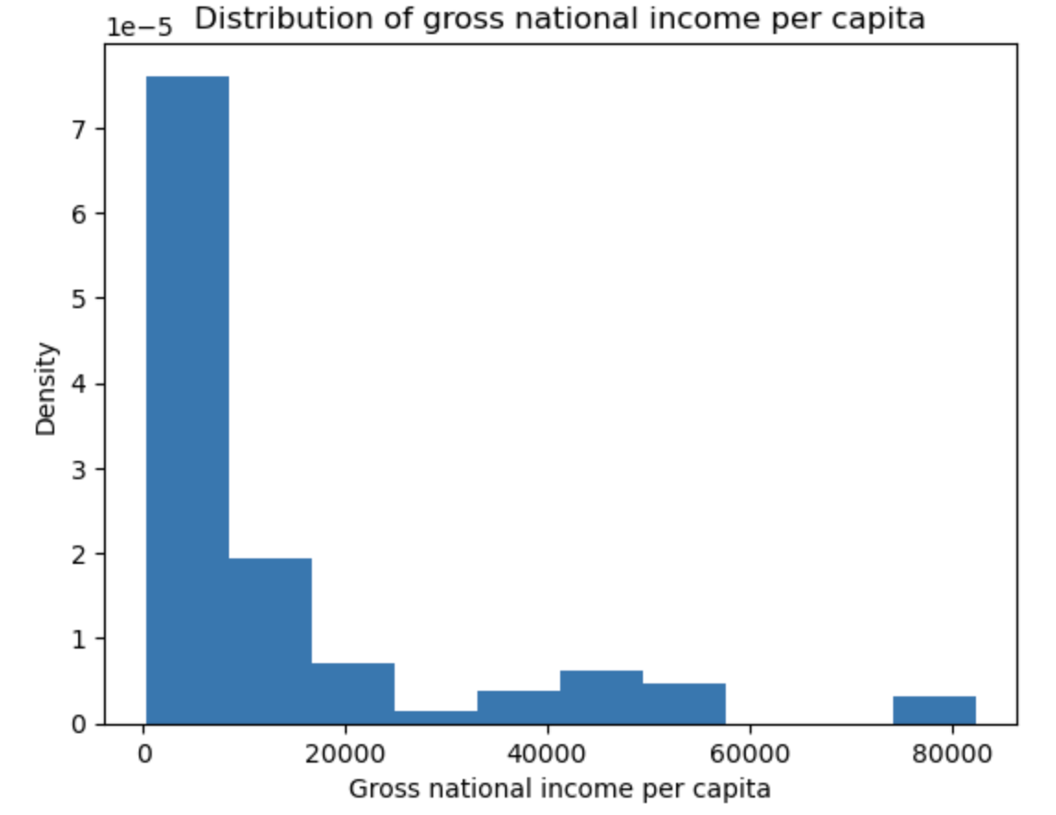
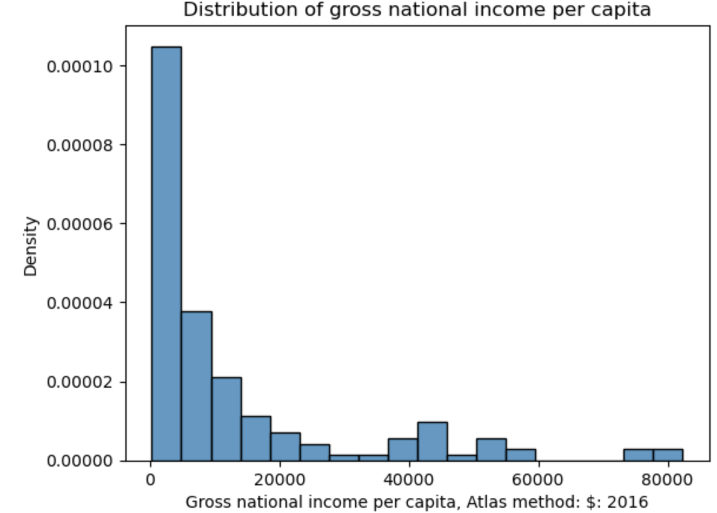
Histograms in Code
In Matplotlib: plt.hist(x_values, density=True)
In Seaborn: sns.histplot(data=df, x="x_column", stat="density")
Matplotlib
Seaborn

Slide 28
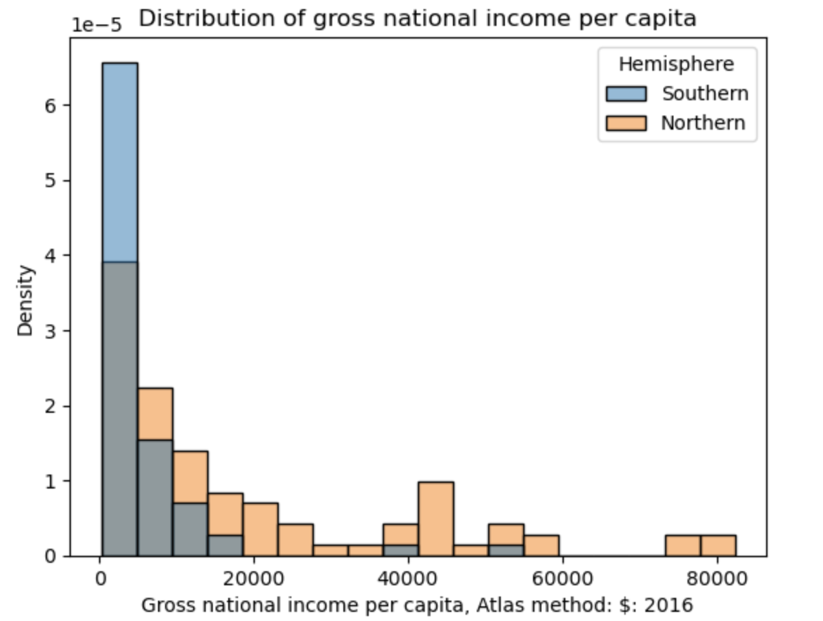
Overlaid Histograms
To compare a quantitative variable's distribution across qualitative categories, overlay histograms on top of one another.
The hue parameter of Seaborn plotting functions sets the column that should be used to determine color.
sns.histplot(data=wb, hue="Hemisphere", x="Gross national income…")
Always include a legend when color is used to encode information!

Slide 29
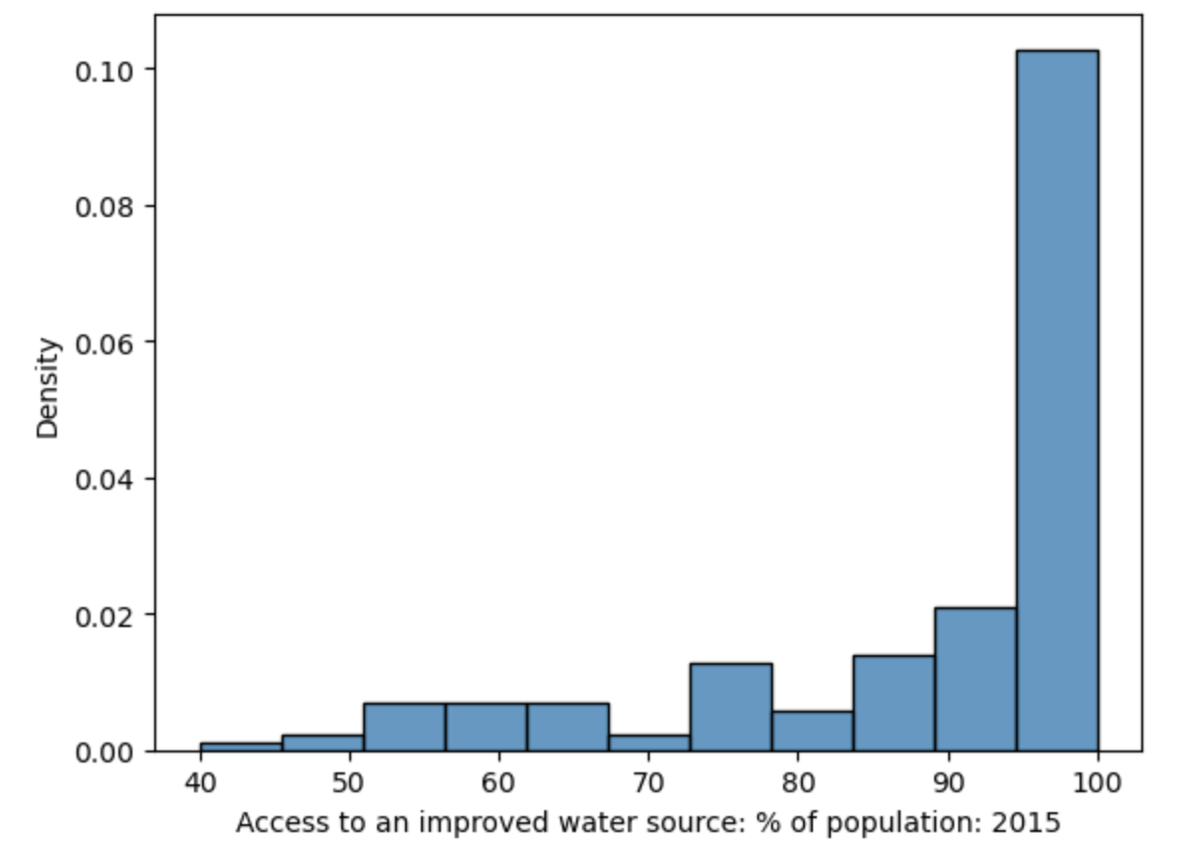
Interpreting Histograms
The skew of a histogram describes the direction in which its "tail" extends.
A distribution with a long right tail is skewed right.
A distribution with a long left tail is skewed left.
A histogram with no clear skew is called symmetric.
A long right tail
A long left tail

Slide 30
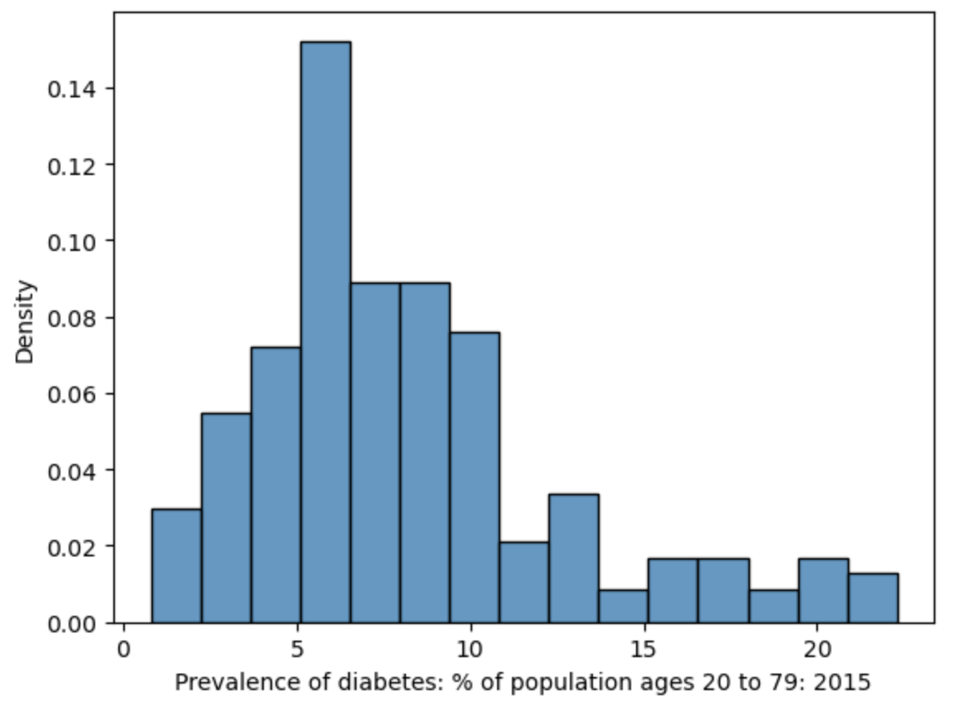
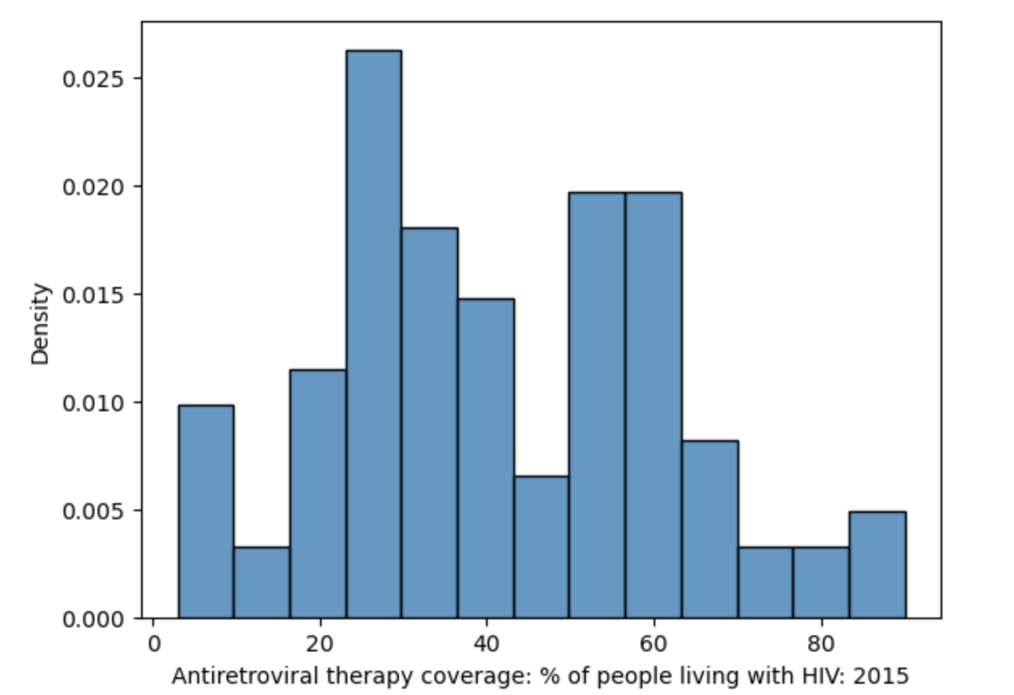
Interpreting Histograms
The mode(s) of a histogram are the peak values in the distribution.
A distribution with one clear peak is called unimodal.
Two peaks: bimodal.
More peaks: multimodal.
Bimodal?
Unimodal

Slide 31
Kernel Density Estimation
Goals of visualization
Visualizing distributions
Kernel density estimation

Slide 32

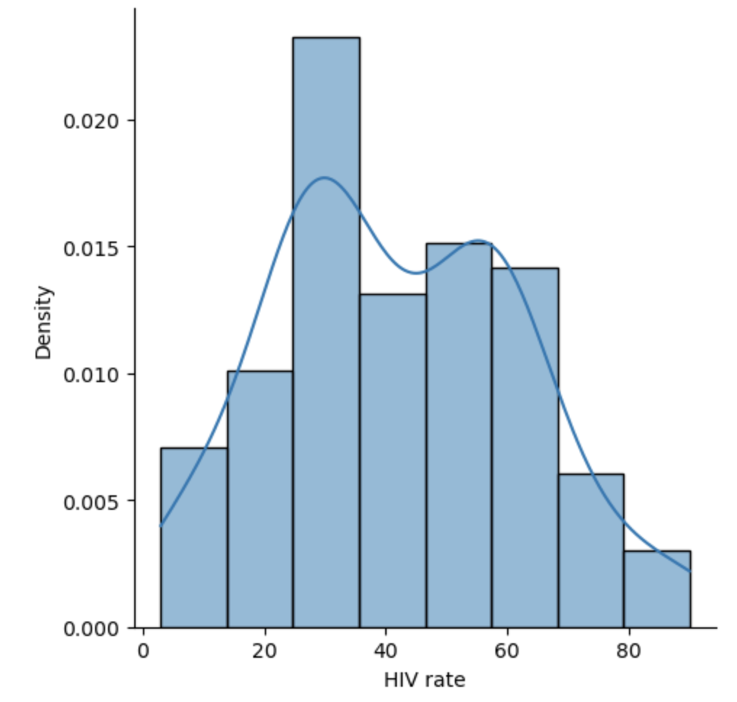
Kernel Density Estimation: Intuition
Often, we want to identify general trends across a distribution, rather than focus on detail. Smoothing a distribution helps generalize the structure of the data and eliminate noise.
3717304
A KDE curve
Idea: approximate the probability distribution that generated the data.
Assign an “error range” to each data point in the dataset – if we were to sample the data again, we might get a different value.
Sum up the error ranges of all data points.
Scale the resulting distribution to integrate to 1.

Slide 33
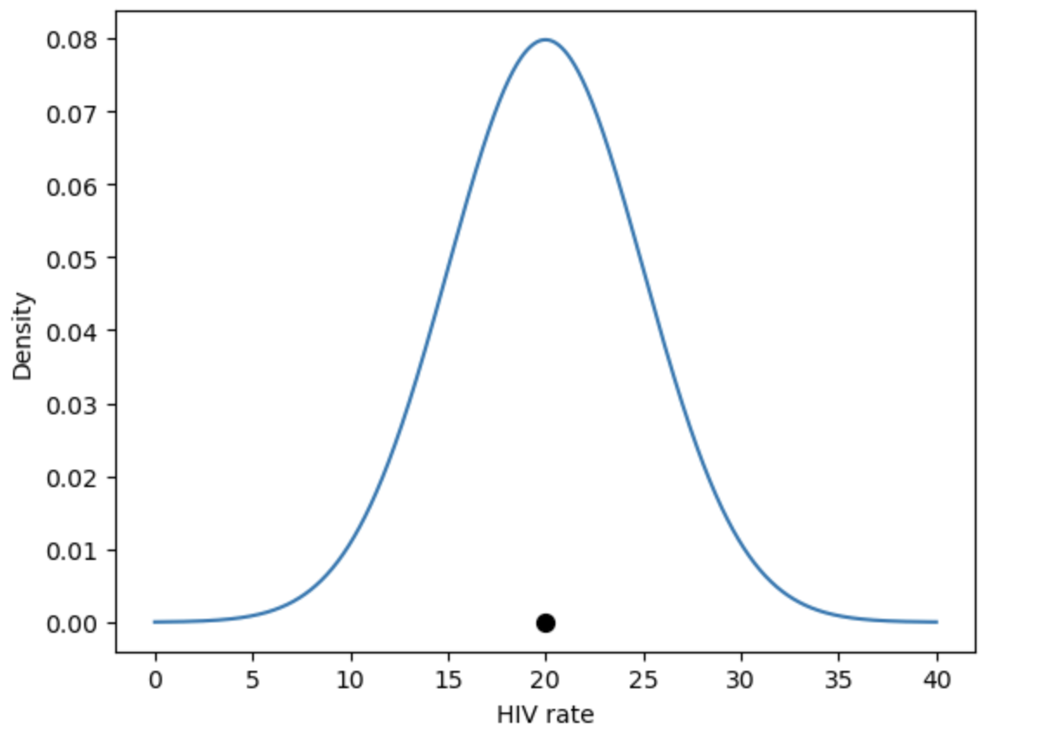
Kernel Density Estimation: Process
Idea: Approximate the probability distribution that generated the data.
Place a kernel at each data point.
Normalize kernels so that total area = 1.
Sum all kernels together.
3717304
A kernel is a function that tries to capture the randomness of our sampled data.
The kernel models the probability of us sampling that datapoint.
Area below integrates to 1
A datapoint in our dataset

